Slide 1





Setup: IDE and Source Control
CS 201, Summer 2013

Slide 2
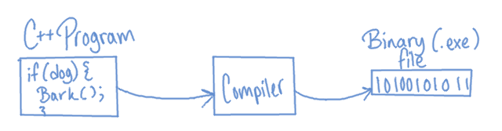
A little bit about software
Most programming languages get compiled from the language (ie, C++) to machine code (Binary). Compiling is the process where the human-readable C++ code is “translated” to something the computer can read and work with (a .exe file in Windows).

Slide 3



A little bit about software
Compiling is specific to a certain type of architecture, so something you build on Windows won't run on OSX or Linux unless you re-compile it for that platform.
There are also scripting languages, like Python. These work differently than compiled languages in that, rather than being compiled into machine code, the Python script runs in the Python program.

Slide 4
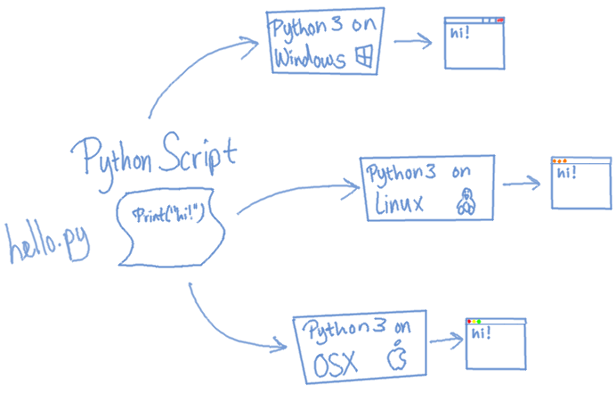
A little bit about software
With a scripting language, a computer just needs to install Python itself, and then it can run your Python scripts without any (or much) tweaking for a specific operating system.
Java is similar to a scripting language, in that it runs through a Java VM (Virtual Machine).
However, Java is still compiled – to bytecode.

Slide 5
Development Environment
IDE (“Integrated Development Environment”)
  A software tool
  Usually contains text-editor to write code, debugger, compiler, and other features useful in software development.
  An IDE is not a Compiler
  IDEs:
    C++: Visual Studio, Code::Blocks, Qt Creator, Eclipse, ...
    Python: IDLE, PyDev, PyScripter, ...

Slide 6
Development Environment
IDEs aren't required to compile C++ code. You could write your code in a text-editor like Notepad++
Then you can compile directly through the gcc compiler (Linux/UNIX), mingw (Windows), Clang, or CL (Windows).
Visual Studio uses CL, other IDEs may use different compilers.
We'll be using IDEs for this class, though.

Slide 7
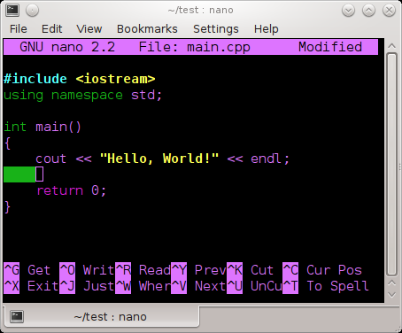
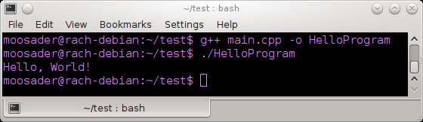
Use whatever floats your boat
Using the nano CLI (Command-Line Interface) text editor to write a C++ program
Building main.cpp with g++ and running it in the terminal

Slide 8
Setting up your Dev Environment
The computers in UMKC's lab are running Visual Studio 2010.
  As a student, you can get a copy of VS2010 pro.
  You can also download Visual C++ Express for free, for Windows.
  You can also use another IDE – for Windows, Linux, OR OSX.

Slide 9
Setting up your Dev Environment
IDEs:
  Visual C++ Express
  http://www.microsoft.com/visualstudio/eng/products/visual-studio-express-products
  Code::Blocks
  http://www.codeblocks.org/
  Eclipse
  http://www.eclipse.org/downloads/packages/eclipse-ide-cc-developers/junosr2
  Xcode
  https://developer.apple.com/xcode/
I prefer Code::Blocks, but Visual Studio is widely used in the job environment. All IDEs have compiling & debugging features + more.

Slide 10
Install an IDE!
I would suggest making sure that you can work on programming assignments from home, so make sure to install an IDE or get remote access to UMKC's remote labs.

Slide 11
Source Control
Back up your work at regular intervals to a server (online, locally, etc.)
Keep track of changes you make to your code over time
Restore backups if you break the program or don't like a change you made
Access from any of your computers
In the future: Help with working with other programmers – merging code & working at the same time.

Slide 12
Source Control
Heavily used in the professional software development world.
Once you get the hang of it, you won't want to write a single line of code without source control ever again (at least – I don't!)
Intro to Source Control video:
http://www.youtube.com/watch?v=K0mgc3efx-A
Class webpage is hosted on GitHub!

Slide 13
Source Control with Git & GitHub
We are going to use the Git source control solution for this class, hosted on the GitHub website.
Usually, GitHub is free for public, open-source projects.
If you have a student email address, you can get private hosting for free.
Can download easy-to-use client for Windows and Mac.

Slide 14
Source Control with Git & GitHub
Register for a student account
https://github.com/edu
Download the GitHub client
Windows: http://windows.github.com/
Mac: http://mac.github.com/
Linux: If you're running Linux, it's assumed that you're adept enough with technical thigns to use Git from the command line or find a Linux UI Git client.

Slide 15
Create a CS201 Repository
Create a “CS201” repository
  A repository is where your code is stored on the GitHub server. You can create as many repos as you want for different projects.
  You can create a new repo either on GitHub.com or through the client.

Slide 16
Create a CS201 Repository
Create a repo from GitHub for Windows/Mac
  Click the “+add” and name the repository “CS201”.
  Make sure you check “Push to github” and “Keep this code private”, then cilck “Create”

Slide 17
(Insert GitHub for Windows screenshots)

Slide 18
Create a CS201 Repository
Create a repo from your GitHub.com profile
  Your profile on GitHub is at github.com/yourusername
  From this page, click the “Repositories” tab
  Click the “New” button.
  Enter a Repository name, click the “Private” radio button, and click “Create Repository”

Slide 19
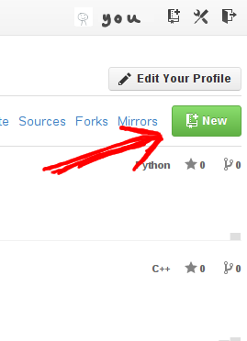
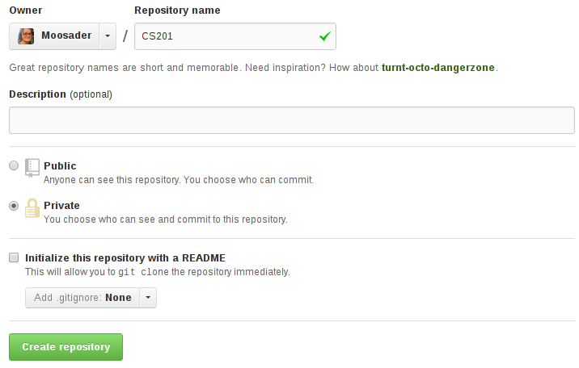

Slide 20
Share CS201 Repository with me
Go to the repository page on github.com
  From the client, right-click on the repository and click “view on github”.
On the repository's webpage, click “Settings”
Click on the left “Collaborators” tab
Under “Manage Collaborators”, highlight the “Add a friend” textbox and type “Moosader”
Click “Add”

Slide 21
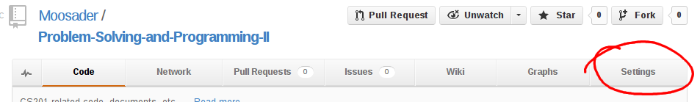
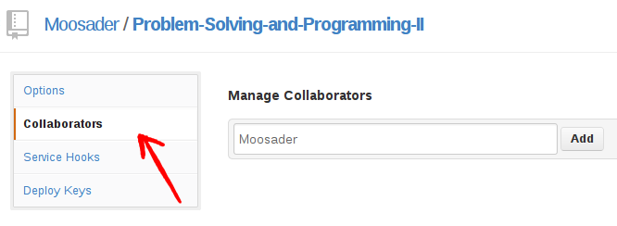

Slide 22
Commit your first file
In the GitHub client, you can view local and github repositories. Select the CS201 repository and clone it to your harddrive, if it is not already.
Open the CS201 folder on your harddrive and create a folder named “Week01”.
Inside the Week01 folder, create a new text file: “test.txt”. Add some text to it, save, and close.

Slide 23
Commit your first file
Go back to the GitHub client. It should show that there are uncommitted changes, and expects comments.
Enter a title describing this change.
Click “commit”

Slide 24
Commit your first file
Commits
Committing won't push the changes to the online server automatically.
Sync (Push)
The Sync button will pull down any changes from the server (there shouldn't be any, unless you update from another computer), and then push your changes to the server.

Slide 25
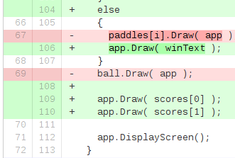
Committing
You can make as many commits as you want before pushing your changes to the GitHub server.
Commits essentially serve as a “snapshot” backup of your code.
You will be able to view changes that have been made between different commits
A sample “diff” - differences between two commits.
Red = removed lines of code,
Green = added lines of code.

Slide 26
Pushing/Syncing
Once you've clicked the “sync” button, your changes will be uploaded to the GitHub server.
Go to your repository's webpage on GitHub – you can now view any files you've committed online! You can even open test.txt to preview it.

Slide 27
Other GitHub features
On your repository's GitHub page, there is a line of buttons across the top:
Code, Network, Pull Requests,
Issues, Wiki, Graphs, and Settings

Slide 28
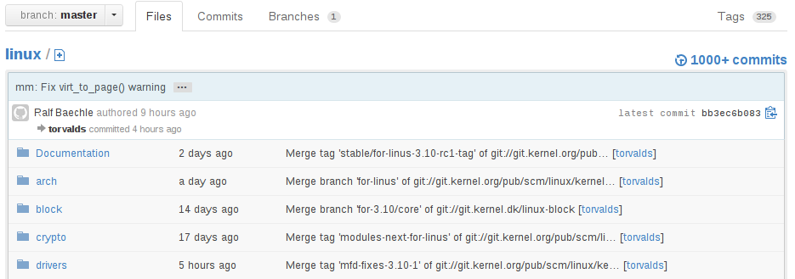
The “Code” tab
On this tab, you can view the files that have been committed to the server under the “Files” tab.
The Linux operating system on GitHub

Slide 29
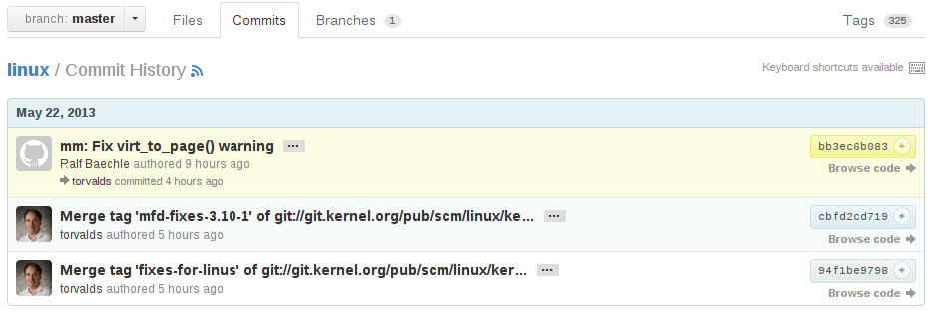
The “Code” tab
Under the “Commits” tab, you can view a list of changes you have made, and do a diff to see the changes.
The Linux operating system on GitHub

Slide 30
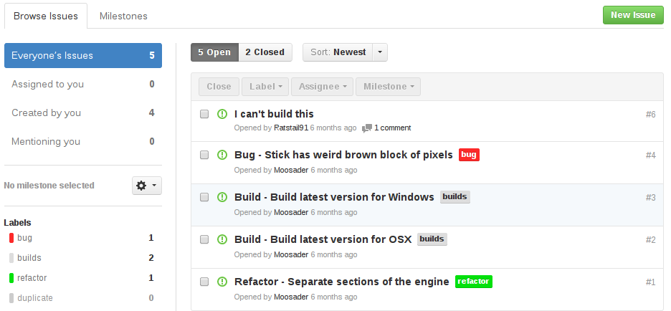
The “Issues” tab
Here you can log bugs, or even use it as a “To-do” list.
Pickin-Open-Sticks game

Slide 31
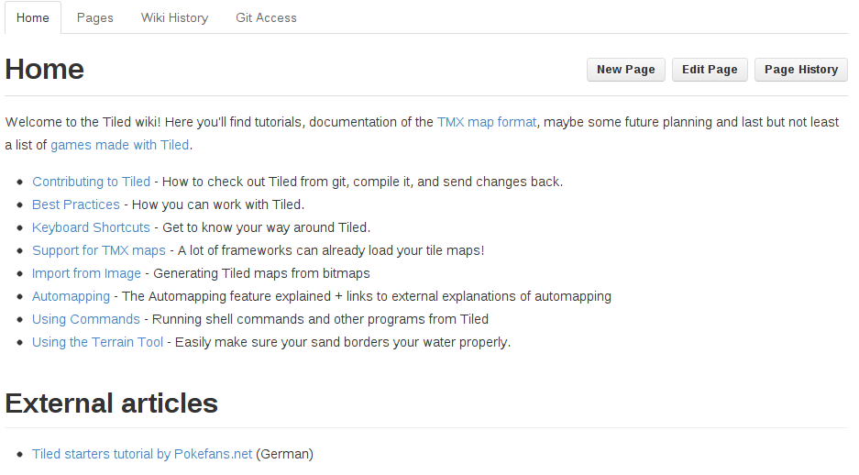
The “Wiki” tab
You also have a small Wiki available to your project, if you wanted to keep notes or make documentation.
bjorn/tiled

Slide 32
Cool projects on GitHub
Linux
https://github.com/torvalds/linux
Doom 3 and iD software games
(John Carmack briefly went to UMKC and he grew up in Raytown & Prairie Village!)
https://github.com/id-Software
Django, a web framework with Python
https://github.com/django/django
Frogatto, a platformer game
https://github.com/frogatto/frogatto

Slide 33
Cool projects on GitHub
Tiled, a 2D tile map editor
https://github.com/bjorn/tiled
AGS Adventure Game Studio
https://github.com/adventuregamestudio/ags
Prince of Persia for the Apple ][
https://github.com/jmechner/Prince-of-Persia-Apple-II
And there are more on other source-hosting websites!

Slide 34
Other Hosting Services
SourceForge (http://sourceforge.net/)
Open-Source hosting only
CodePlex (http://www.codeplex.com/)
Open-Source hosting only, ran by Microsoft
Google Code (http://code.google.com/)
Open-Source hosting only, ran by Google
BitBucket (https://bitbucket.org/)
Has free hosting for public & private projects
& many more (https://en.wikipedia.org/wiki/Comparison_of_open-source_software_hosting_facilities)

Slide 35
Source Control solutions
Git
http://git-scm.com/
SVN (Subversion)
http://subversion.tigris.org/
Mercurial (hg) – Similar to Git
http://mercurial.selenic.com/
TFS (Team Foundation Server, from Microsoft)
http://msdn.microsoft.com/en-us/vstudio/ff637362.aspx
StarTeam
http://www.borland.com/products/starteam/default.aspx
& more

